Slide 1

Focus Time
Group 4: Christopher Senn, Shaohua Tong, Julian Reff, Jelena Pranjic
Notes:
Hello everyone, I’m Jelena & I’m going to be presenting for Group 4. Our app is called Focus Time.

Slide 2
What is Focus Time?
Notes:
So, what does Focus Time do & what is it used for?

Slide 3

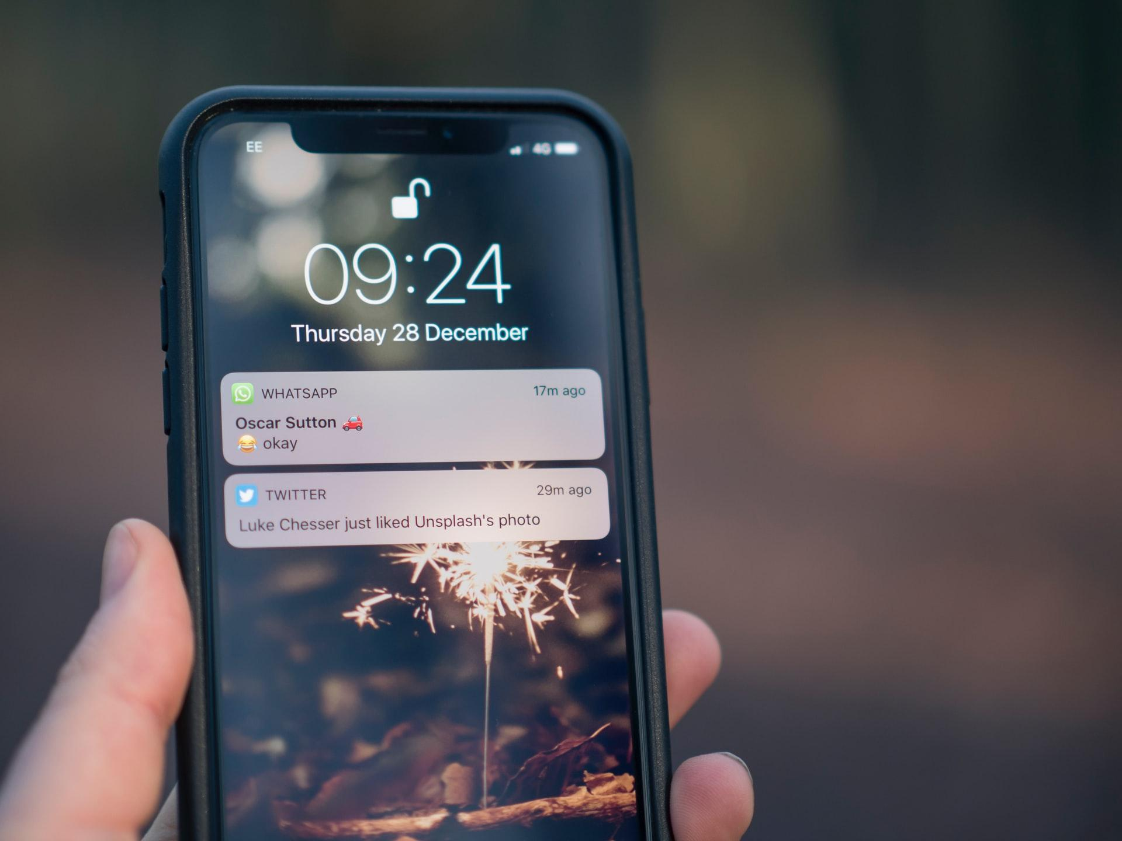
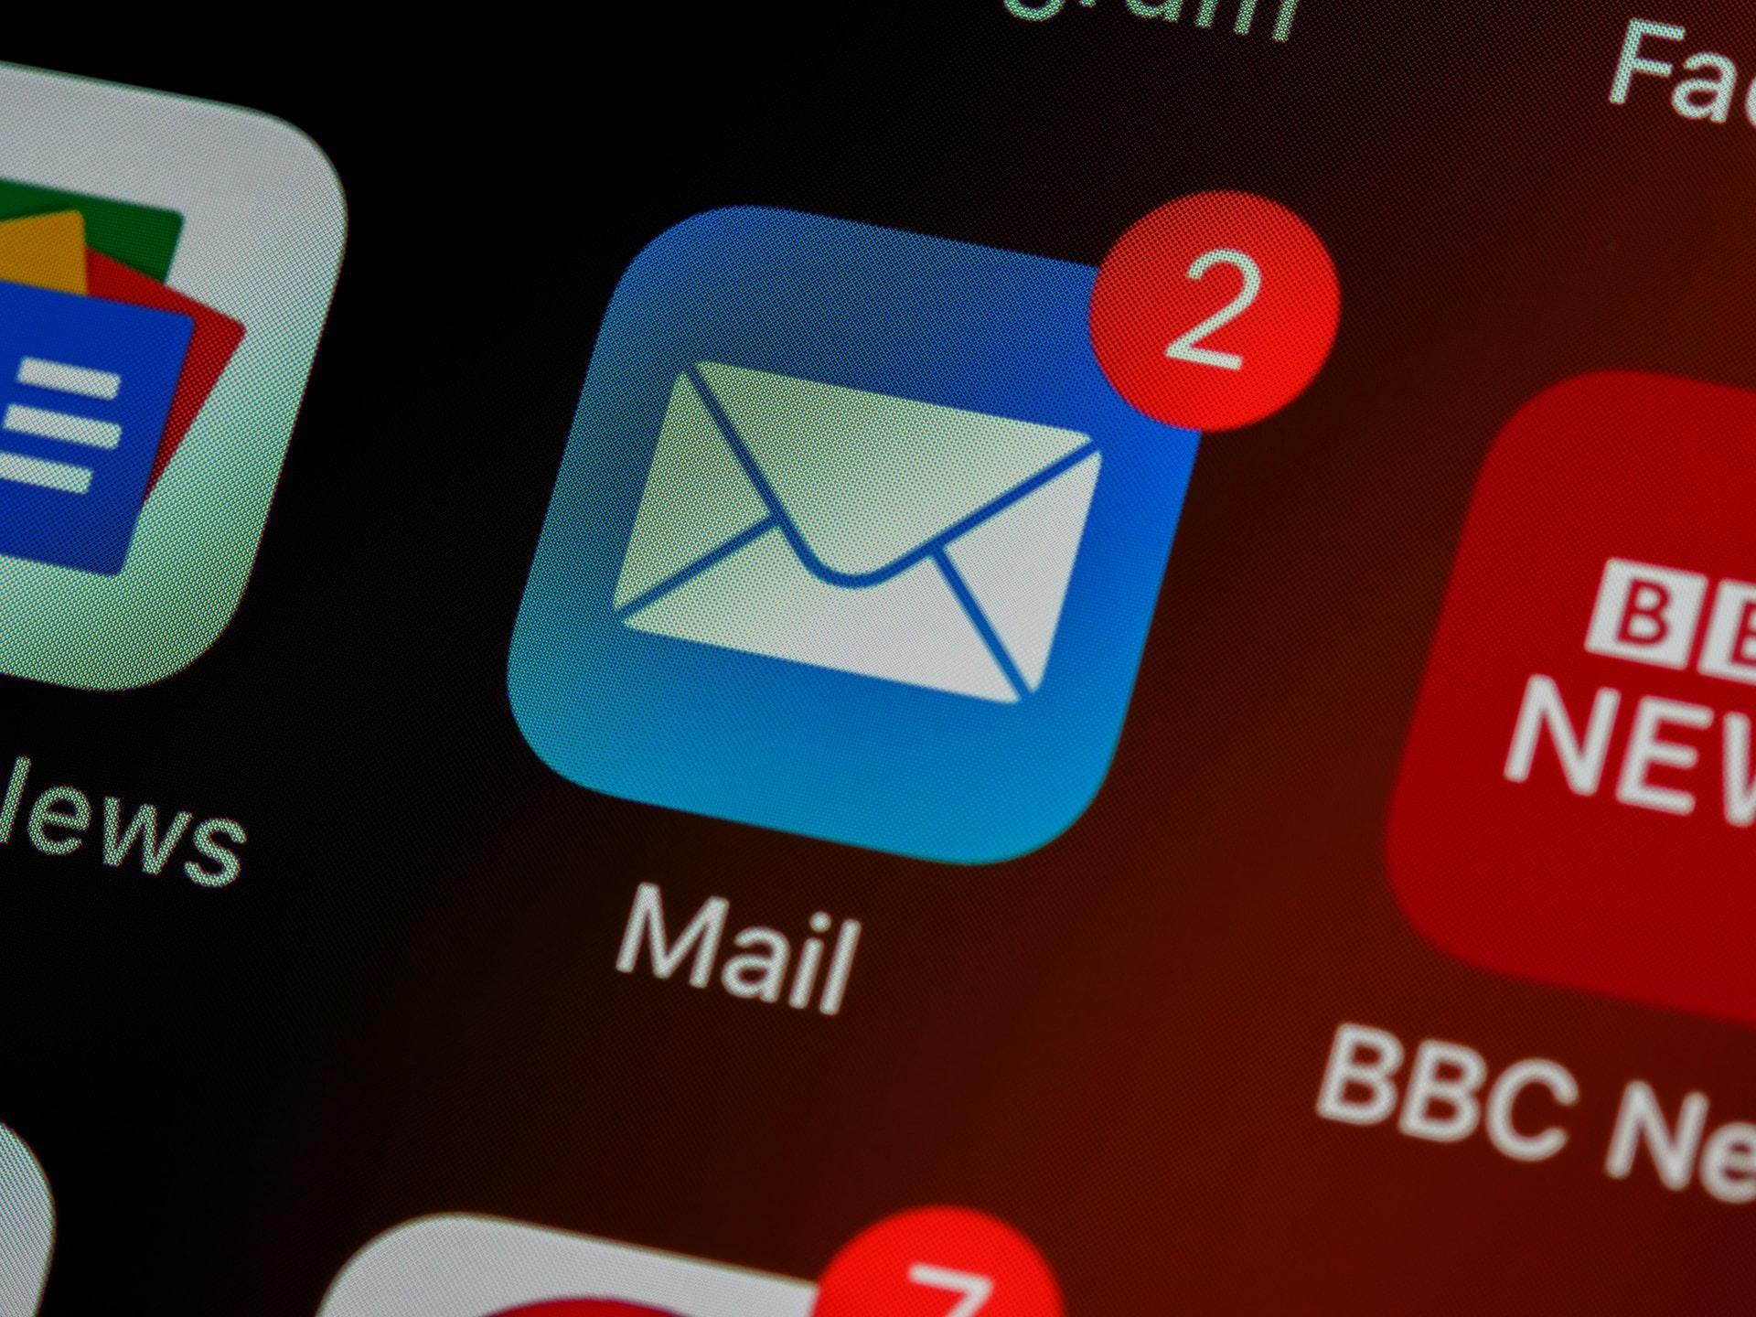
Notes:
Imagine you are at home & you must study for an exam.
For most of us, it is not as easy to just sit down and do it, we might procrastinate and get distracted by our phones.
Even when we sit down and finally start studying, there is a chance that we might receive notifications on our phone that catch our attention and distract us from studying once again. Now that is where our app Focus Time comes into play. We developed an app that can help students and other people who, for instance, work from home, to work more effectively and organize their work or study time more easily.

Slide 4
How can Focus Time help you?
Notes:
How exactly can Focus Time help you to achieve that?

Slide 5



Features
Calendar
Schedule your “focus times”
Block notifications during focus time
Notes:
First, the app has a calendar to help you organize your time. It gives you an overview of your schedule. For instance, you see when you have your next exam & when you plan to study for it and any other appointments.
Within the app it is possible to set yourself so called “focus times”. For example, you plan on studying on Tuesday from 2-4pm. You set this in the app, and it will automatically block any notifications on your phone during that time.

Slide 6


Features
Different “levels” of blocking notifications
Set schedule for “focus time” or start them immediately
Import events from personal calendar
Notes:
There are also 3 different levels for blocking the phone’s notifications. You can set your phone to total silence or allow certain alarms or sounds. This is how you can make sure to not miss an important message or call.
On top of that, you also have the possibility to start a focus time immediately without scheduling it. You just press a “start” button & the phone gets into DND mode and starts a timer for your focus time.
And lastly, you can also import events or appointments from your personal calendar into the focus time calendar, so you don’t have to do it manually.
These are all the features of the Focus Time app & now I’m going to go into more detail on how we developed it.

Slide 7
Our Approach
Brainstorming
Development
Final
Product
Concept
Design
Testing Adapting Design
Notes:
First, we brainstormed a couple of ideas together, and eventually developed a concept for our app. Afterwards we started developing some functionalities while also working on a design for the app to have enough time to test and adapt the design.
After we settled on the final design for our app, we integrated it. And again, after some testing and fixing bugs, we achieved the final product.

Slide 8
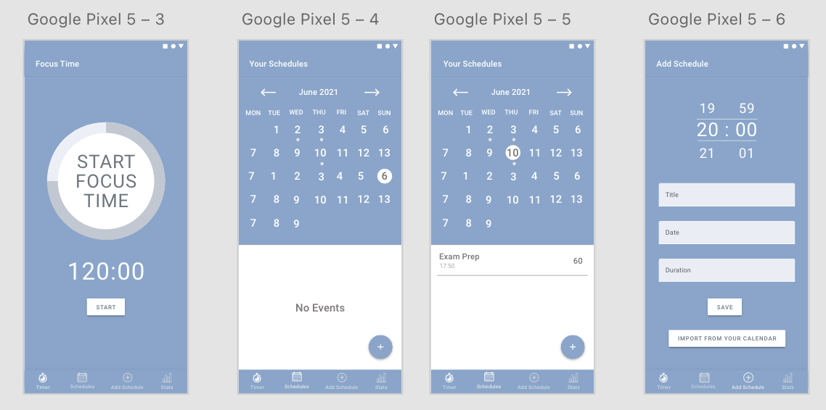
The Design
Notes:
Lastly, before we show you a demo of our app, I would like to give you an introduction to the design prototype of our app and explain some design decisions we made.
As you see, we have chosen to not use a hamburger menu but a bottom navigation tab bar, so the user has an immediate overview of options. This also saves some time as the user does not have to open a menu first.
For our calendar view, we decided to show the monthly and daily view in the same screen. This also saves time and provides an immediate overview, and iPhone users might be familiar with this screen as Apple’s calendar uses a similar view. We follow the same approach for the screen where the user adds a new schedule to the calendar. Everything is visible at first glance without being overwhelming. Lastly, we chose this light blue color to have a unique appearance and therefore be easily recognized among other apps. This was just a glimpse into our design decisions and now, I will hand over to Julian who will show you the app in more detail.

Slide 9
App Demo

Slide 10
Technical Details
Reason 1
Reason 2
Feature 3
Notes:
Persistance
API
Worker
Service

Slide 11
Live Demo Steps
Install App (Show permission management)
Manually Start Focus Time
Restart App
Schedule Event for Today
Schedule Focus Time (Plus Icon Calendar)
Edit Focus Time
Show importable Events (Normal - Daily - Weekly - Monthly)
Import Weekly (or something)
Delete One
Show different day views
Now the manual focustime should go off

